Slide 1
Amazon Sales Data Analysis

Slide 2
Objective:
Performing analysis of Sales data and identifying key performance indicators and other insights which can aid decision making and help to further optimize sales. These findings must be presented in a clear, instructive manner in the form of dashboards to easily convey the underlying information to stakeholders.
Benefits:
Optimizing sales.
Gives better insight of customer preference.
Helps in identifying high performing products and employees.
Helps in understanding past performances over time.

Slide 3
Architecture
Dataset stored in Excel sheet
Load csv file to Jupyter notebook
Perform Data Cleaning and Preprocessing
Exploratory Data Analysis
Load Data in Tableau
Create visualizations
Reporting
Publish Dashboard Online

Slide 4
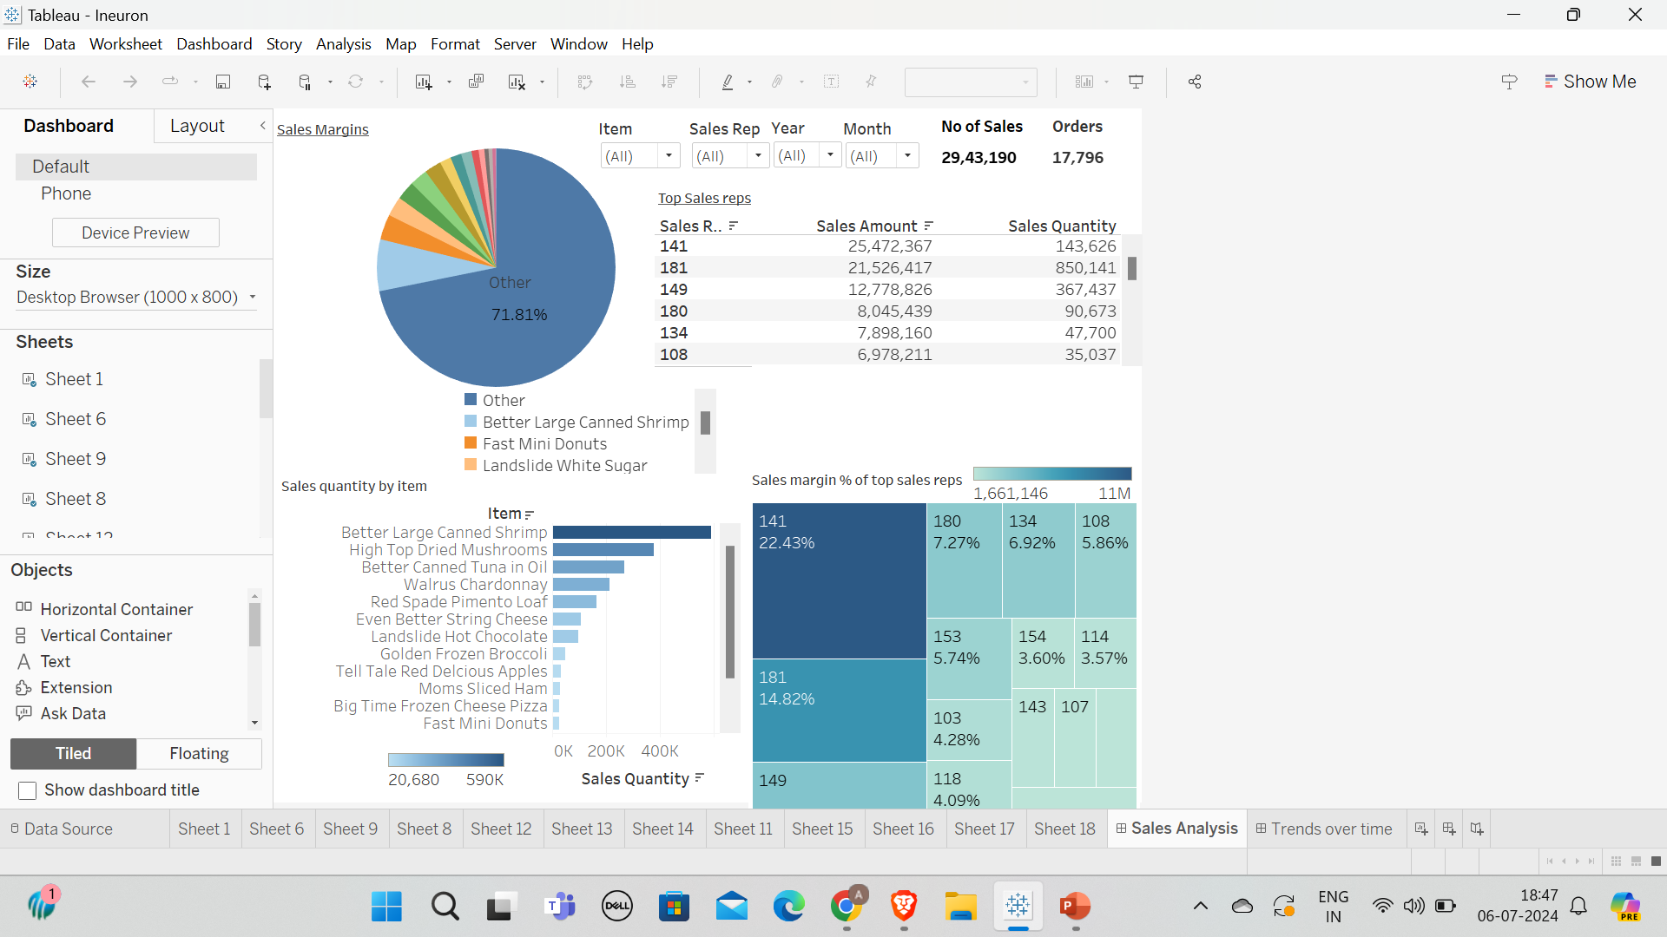
The sales analysis dashboard presented in Figure 1 illustrates various information which has been uncovered from the data. Some of them are:
Sales Quantity by item
Contribution of the top items to the overall sales quantity.
Sale amount and sales quantity contributed by the top sales reps.
Sales margin percentage of top sales reps
We will dive deeper into each of these aspects in further slides.
Figure 1- Sales analysis dashboard

Slide 5
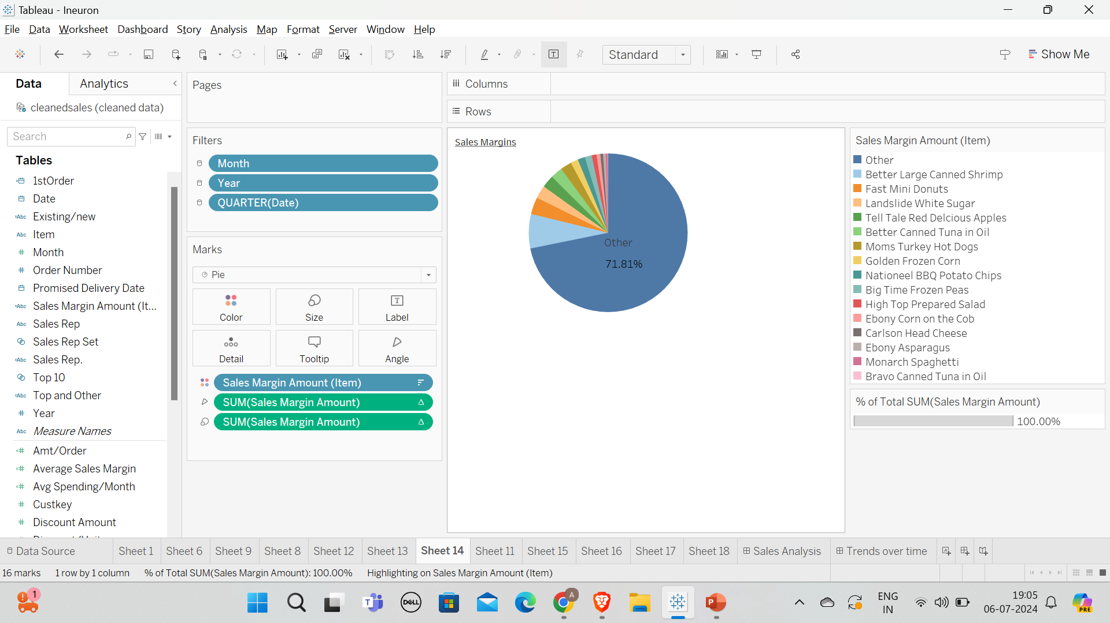
Figure 1a makes use of a pie chart to illustrate the share of Sales margin of the top 15 items in the total Sales margin amount from all sales. It conveys the following information:
Almost 30%(28.19%) of the Total Sales margin comes from the sale of just 15 items.
The top 2 items contribute 10% of Total Sales margin.
Making use of Year and Month slicers can give us the break of Sales margin amount in each year.
Figure 1a- Share of Sales margin amounts of various items in the total Sales Margin

Slide 6
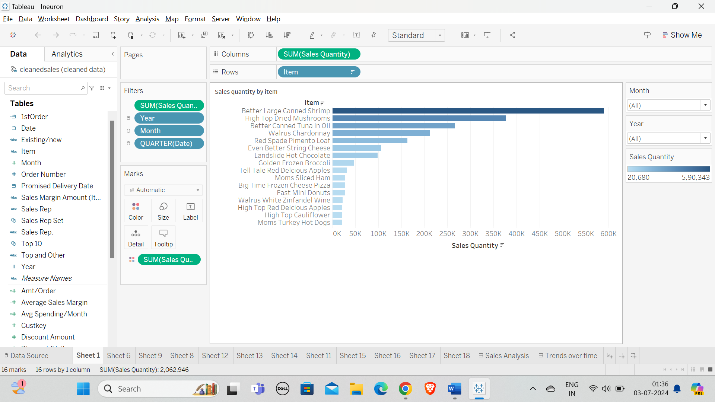
Figure 1b uses a bar chart to illustrate Sales quantity of all the items. This gives the viewer an idea of the items which are most purchased and most popular. Further the following information is conveyed:
Only the top 5 items have more than 150K sales.
The top selling item has almost double the sales of the 2nd item.
All the top 5 items are required for cooking which explains the high demand. Therefore focusing on the cooking items segment will result in higher sales for the company.
Figure 1b- Sales quantity by item

Slide 7
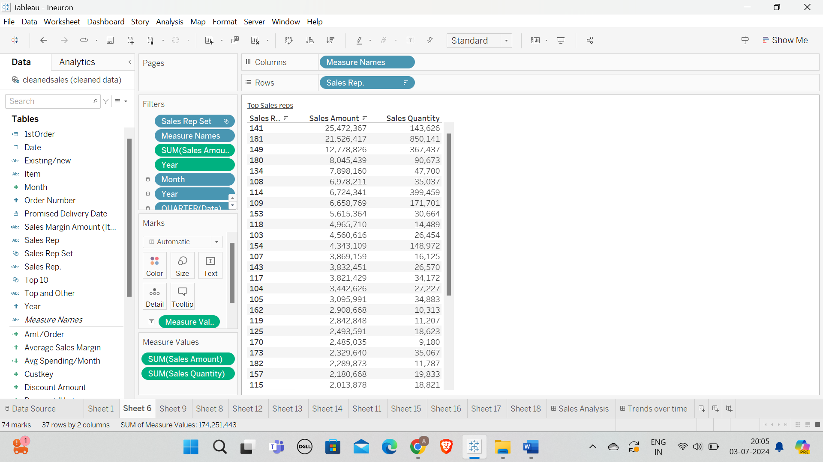
The table in Figure 1c shows the top sales representatives employed by the company. Some key information conveyed is as follows:
The top 9 Sales Representatives have sold items worth over 5 million in total.
The top 3 sales reps breach the 10 million mark in terms of sales amount.
This would provide useful information to the organization about its best employees.
Figure 1c- Top sales representatives

Slide 8
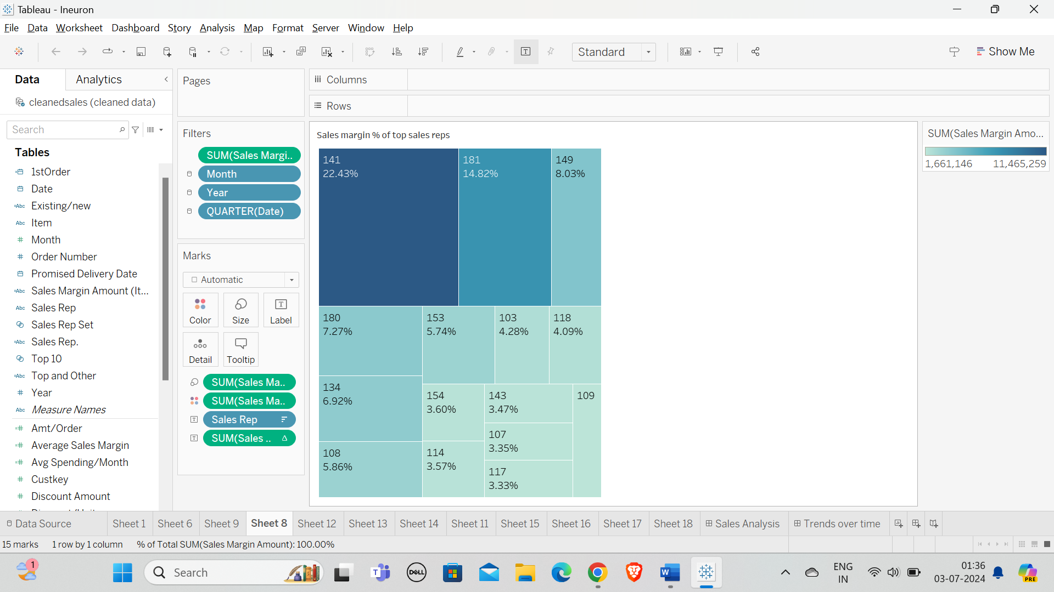
Figure 1d shows the contributions of the top 15 sales reps(in percentage terms) to the total sales margin amount of all sales put together. The following actionable insights can be drawn from the visualization:
The top 4 out of the top 15 sales reps bring in more than 50% of the total sales margin amount. Clearly the organization can reward these high-performing employees.
It is clear that bulk of the sales margin amount is being added by the top sales reps. Therefore the organization needs to improve efficiency.
Figure 1d- Percentage of total sales margin contributed by the top sales reps

Slide 9
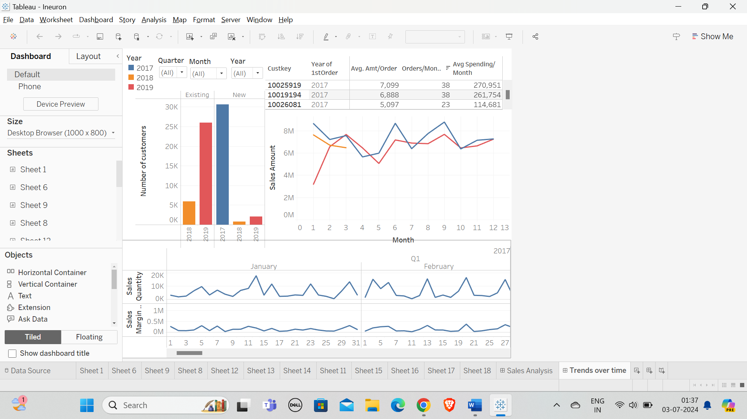
The time series analysis dashboard presented in Figure 2 illustrates various information which has been uncovered from the data. Some of them are:
Number of new and existing customers in each year.
Sales amount over the years.
Sales quantity and Sales margin over time.
We will dive deeper into each of these aspects in further slides.
Figure 2- Time series analysis dashboard

Slide 10
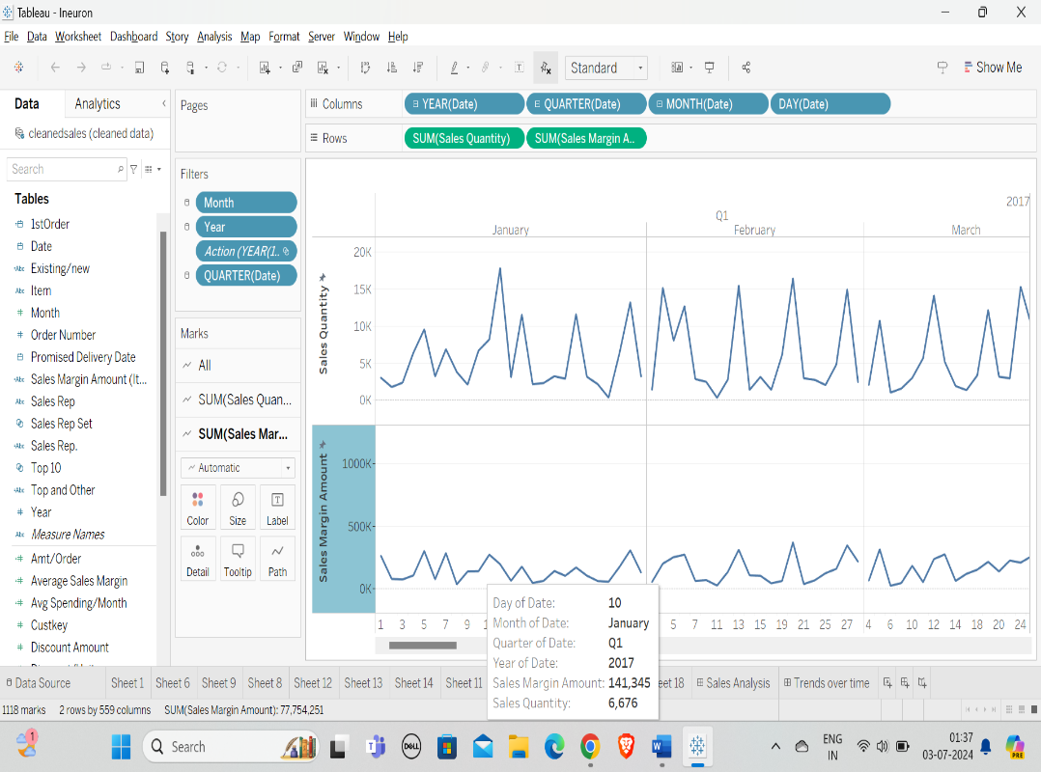
The line charts shown in Figure 2a illustrate the fluctuations in Sales quantity and sales margin over time. The following insights are presented:
The sales quantity and sales margin dips significantly in 3rd quarter of 2019.
Typically June sees higher sales quantity every year.
In both 2017 and 2019 the month of December has seen lower sales quantity.
Figure 2a- Sales quantity and Sales Margin amount variation over time.

Slide 11
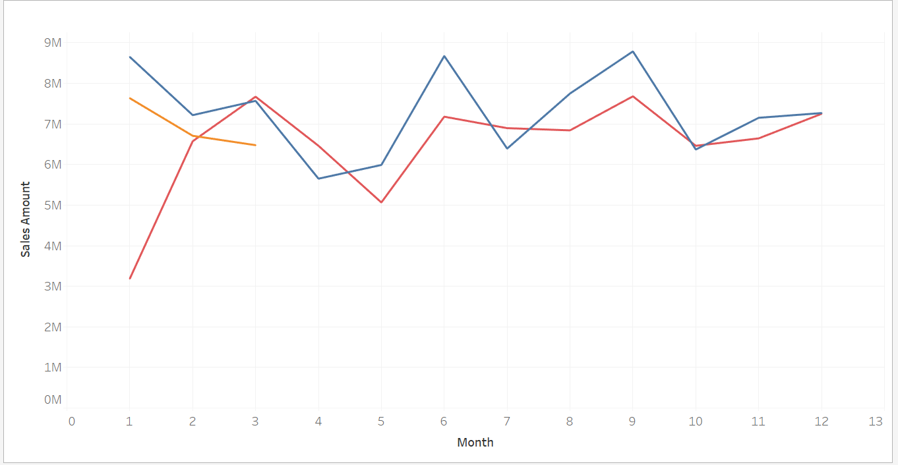
The line chart in Figure 2b shows the trends in sales amount over the months in all the 3 years. It conveys the following insights:
Each year the sales amount at the beginning has been dropping which implies that sales amount has been reducing over the years.
In both 2017 and 2019, the sales amount has picked up in the months of June and August.
Figure 2b- Change in Sales Amount over time

Slide 12
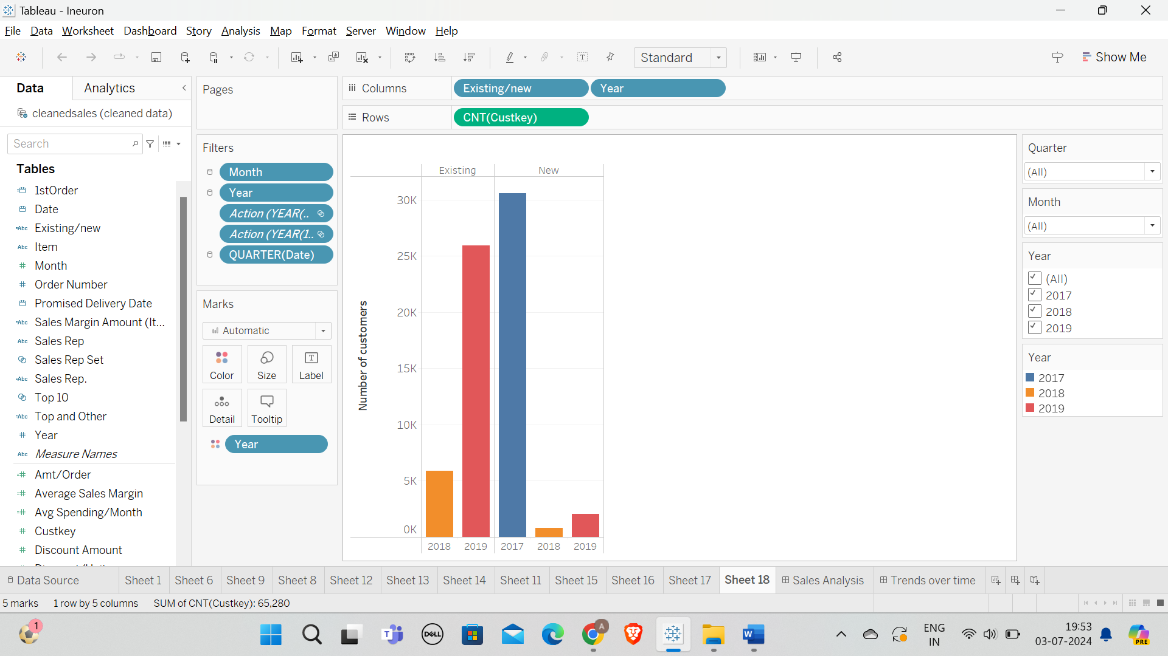
The bar chart in Figure 2c shows the number of new and existing customers in each year. It conveys the following insights:
The year 2017 saw orders placed by 30 thousand new customers.
2018 and 2019 saw a stagnation in growth of customer base with less than 5K orders placed by new customers.
In the year 2019, more old customers placed orders than in the year 2018.
Figure 2c- Number of new and existing customers in each year

Slide 13
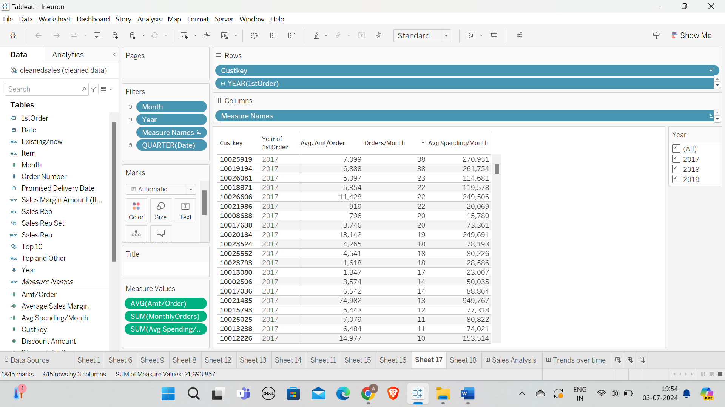
The table shown in figure 2d illustrates the historical spending patterns of customers. By identifying which year they placed their first order, the average amount spent per order, number of orders per month and the average spending per month, it becomes clear how often and for how long the customer has been contributing and in turn can help identify how many regular, long time customers contribute.
Figure 2d- Spending and order patterns of all customers

Slide 14
Q & A:
Q1) What’s the source of data?
The data is sourced from the dataset provided by Ineuron in the project description.
Q 2) What was the type of data?
The data was the combination of numerical and Categorical values.
Q 3) What’s the complete flow you followed in this Project?
Refer slide 3rd for better Understanding

Slide 15
Q 4) What techniques were you using for data pre-processing?
Removing unwanted attributes
Visualizing relation of independent variables with each other and output variables
Removing outliers
Cleaning data and imputing if null values are present.
Creating new calculations or fields which may be useful for further analysis
Editing the names of columns to make them more clear to the audience when presented through visualizations

